Slide 1
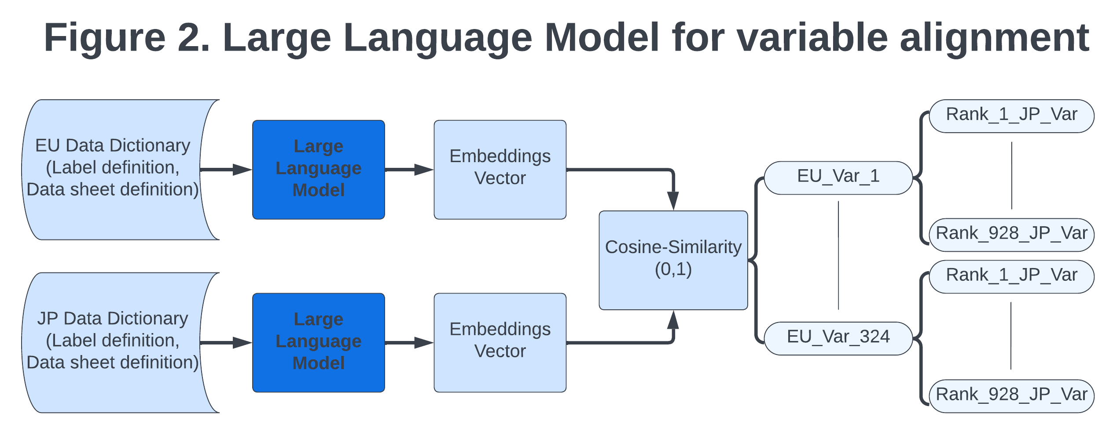
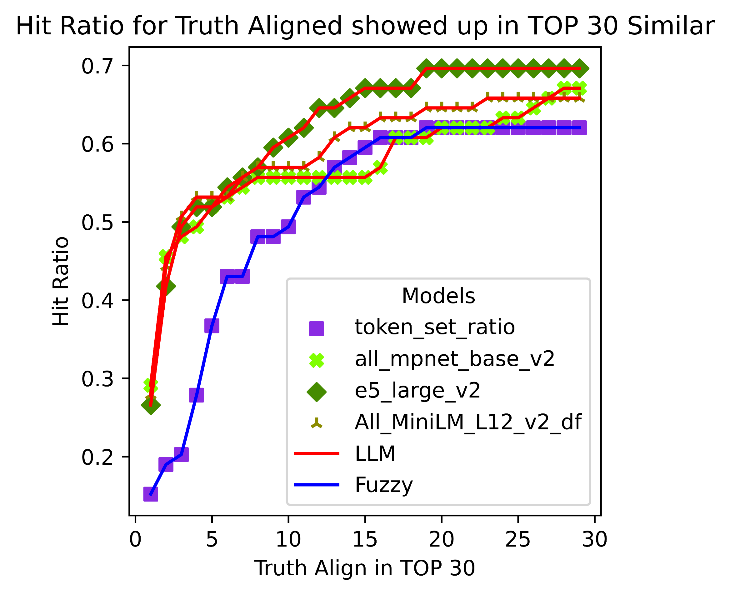
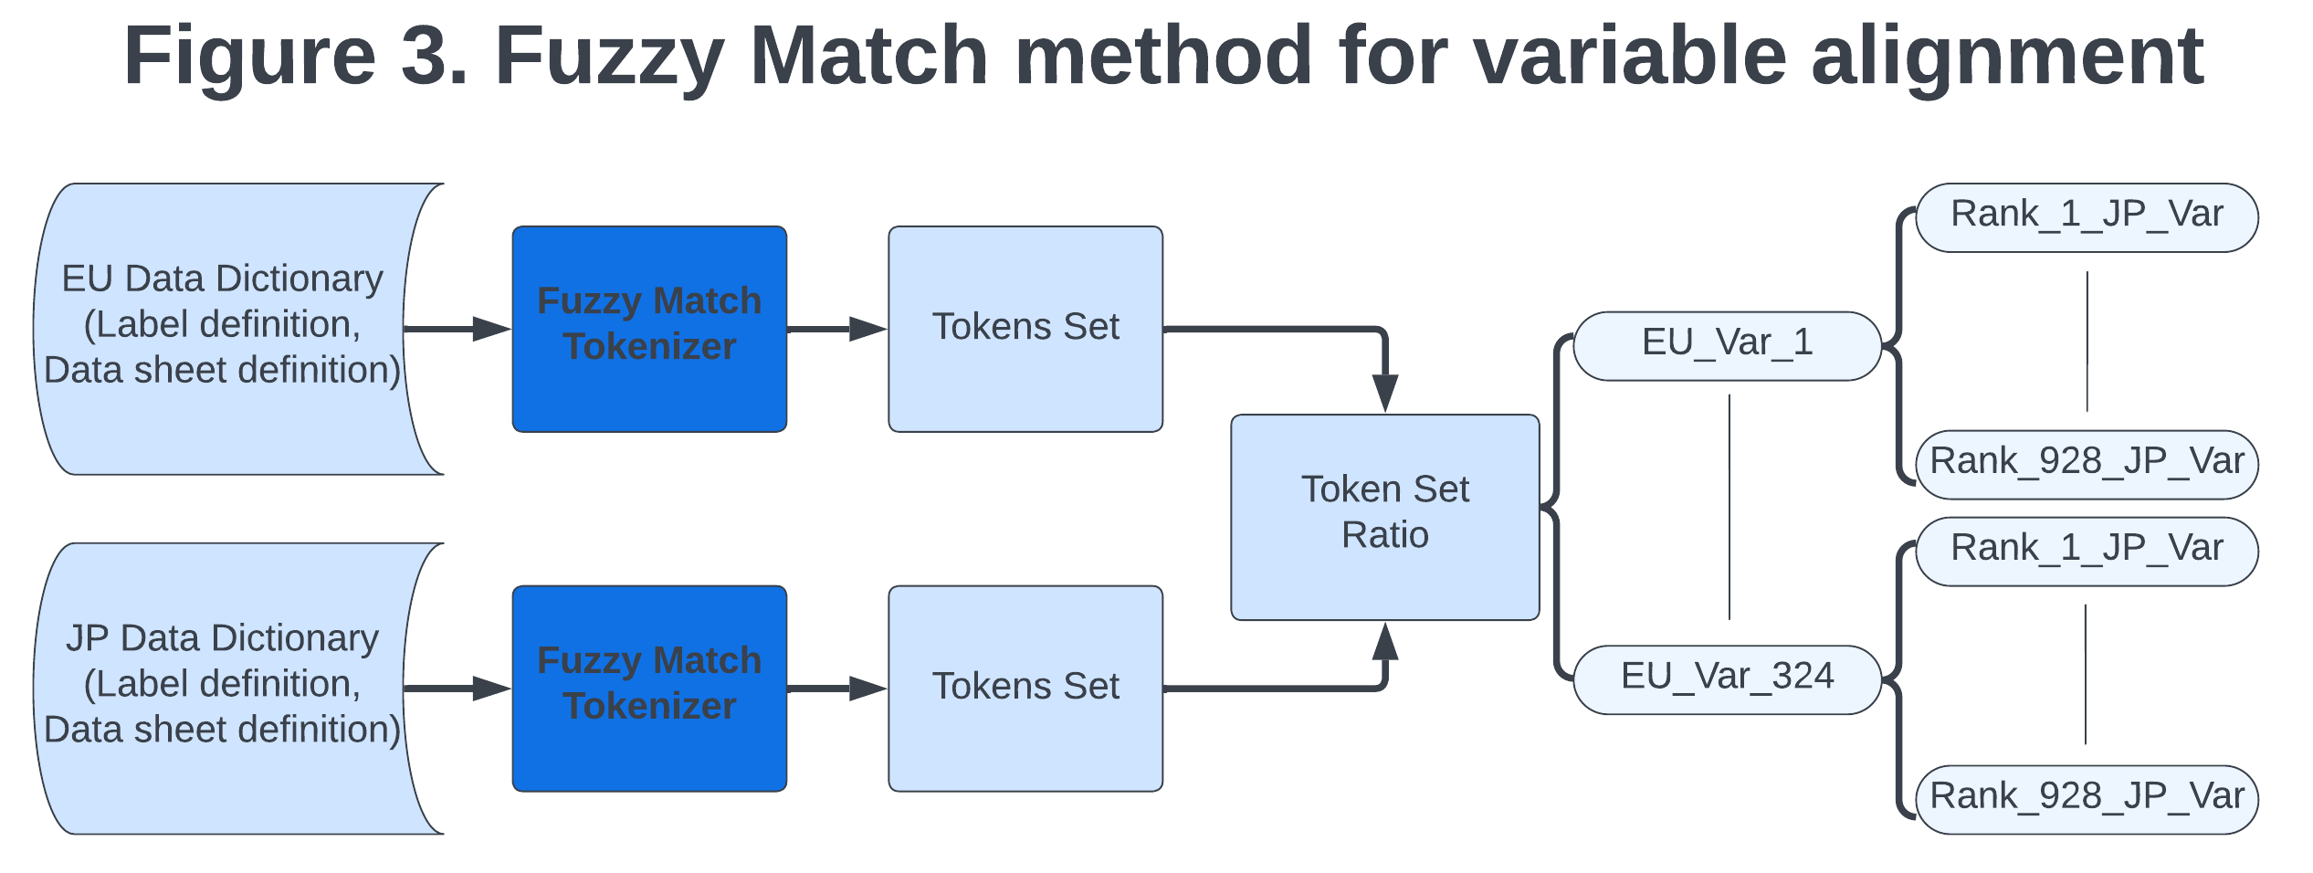
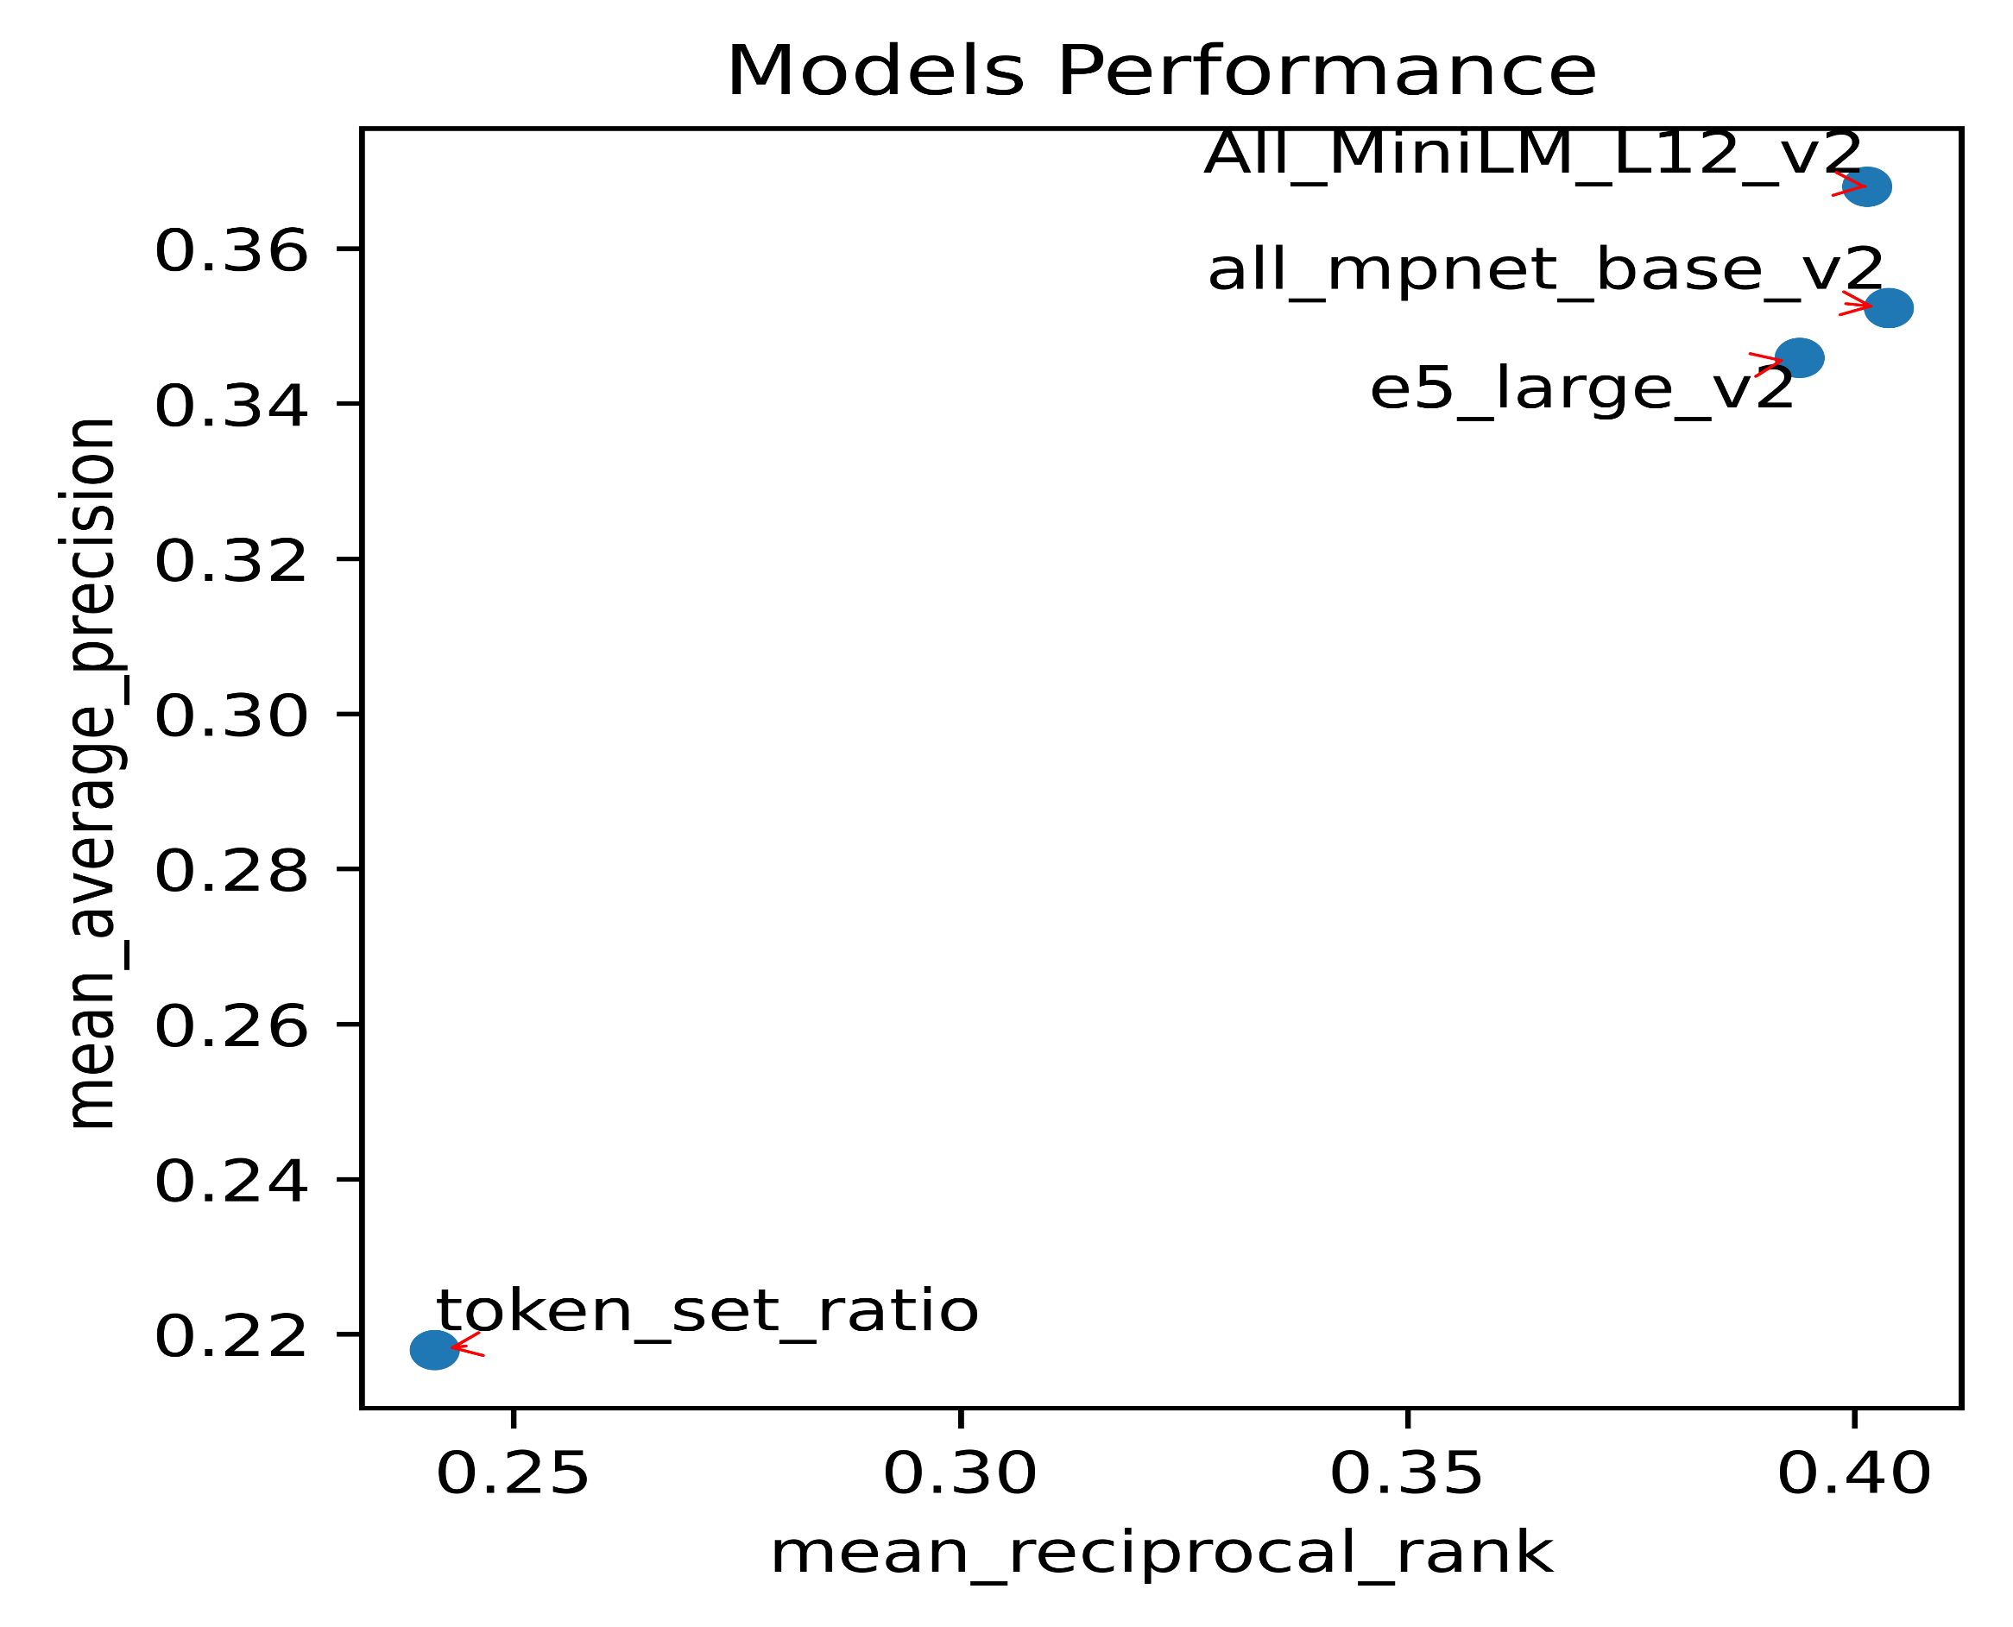


Aligning Variables across Cohort Studies: A Comparative Study of Large Language Models and Fuzzy Match Approaches
Zexu Li, MS¹, Suraj Prashantha Prabhu, MS², Zachary T. Popp, MPH³, Ting Fang Alvin Ang, MD⁴, MPH⁵, Rhoda Au, PHD⁶, Jinying Chen, PHD^{7,8,9}
1. Include department name and university name if needed; 2. Include department name and university name if needed; 3. Include department name and university name if needed; 4. Include department name and university name if needed; 5. Include department name and university name if needed; 6. Include department name and university name if needed; 7. Include department name and university name if needed; 8. Include department name and university name if needed; 9. Include department name and university name if needed
Introduction
Methodology
Results
Merging data collected by multiple studies (i.e., data harmonization) is a common strategy to increase sample size and statistical power of data analysis. However, even studies using similar research protocols for data collection often used different variable names and coding schemes.
Objective: to develop and validate Natural Language Processing (NLP) methods that align variables from different studies to support data harmonization.
Are NLP methods applicable to the variable alignment task?
Which NLP methods have the best performance on variable alignment?
Models | Training Data | Description | Complexity
E5-Large-V2 | 270M sentences pairs | Large language model (LLM), extension of Bidirectional Encoder Representations from Transformers (BERT) | CPU times: total: 27min 28s Wall time: 4min 17s
All-MiniLM-L12-V2 | 1B sentences pairs | LLM, extension of BERT | CPU times: total: 2min 40s Wall time: 53.1 s
All-Mpnet-base-v2 | 1B sentences pairs | LLM, extension of BERT | CPU times: total: 6min 37s Wall time: 1min 29s
Token-set-ratio | None | Fuzzy Match Based on Tokens | Total time: 13.1s
Data and Sample
Source of evaluation data: data variables from European and Japan GERAS cohort studies.
Similar protocol was used to collect data across the two cohorts, but data variables were coded and named differently.
Evaluation metrics: Hit Ratio, Mean Reciprocal Rank, Mean Average Precision
Hit Ratio: Proportion of correct alignments (between source and target variables) in the top-n target variables ranked by the NLP algorithms.
Mean Reciprocal Rank: Mean value of reciprocal rank (one divided by the rank of first appeared correctly aligned target variable).
Mean Average Precision: Mean value of average precision (consider ranks of all correctly aligned target variables).
Truth Map/evaluation set: 160 pairs of source (EU) and target (Japan) variables that were manually identified and validated by three co-authors(ZL, SP, ZTP).
Conclusion
 | Japan Cohort (324 Variables) | EU Cohort (928 Variables)
Variable Label | ADTTERM:AD Treatment Name | SDYTRTTERM: Study Treatment Dictionary Term
Data Sheet | ADTR: All AD medication as recorded | SDYTRT: Study Treatment
Variable Definition | Donepezil, Galantamine, Memantine, Rivastigmine, Yokukansan (Chinese herbal medicine)… | Approved AD treatment Donepezil Galantamine Investigational product Memantine Rivastigmine…
NLP methods showed adequate results for variable alignment tasks.
Large language Models outperformed fuzzy match for aligning variables.
Between the language models, the E5 model has the best performance and MiniLM model has the lowest running time.
Future Work
Improve E5 model using task-specific training data.
Apply same approach to other datasets.
This study is supported by BU-Alzheimer’s Disease Data Initiative (ADDI) Contract. The funder had no decisional role in study design, data collection and analysis, interpretation of data, or preparation of the abstract.

